Slide 1
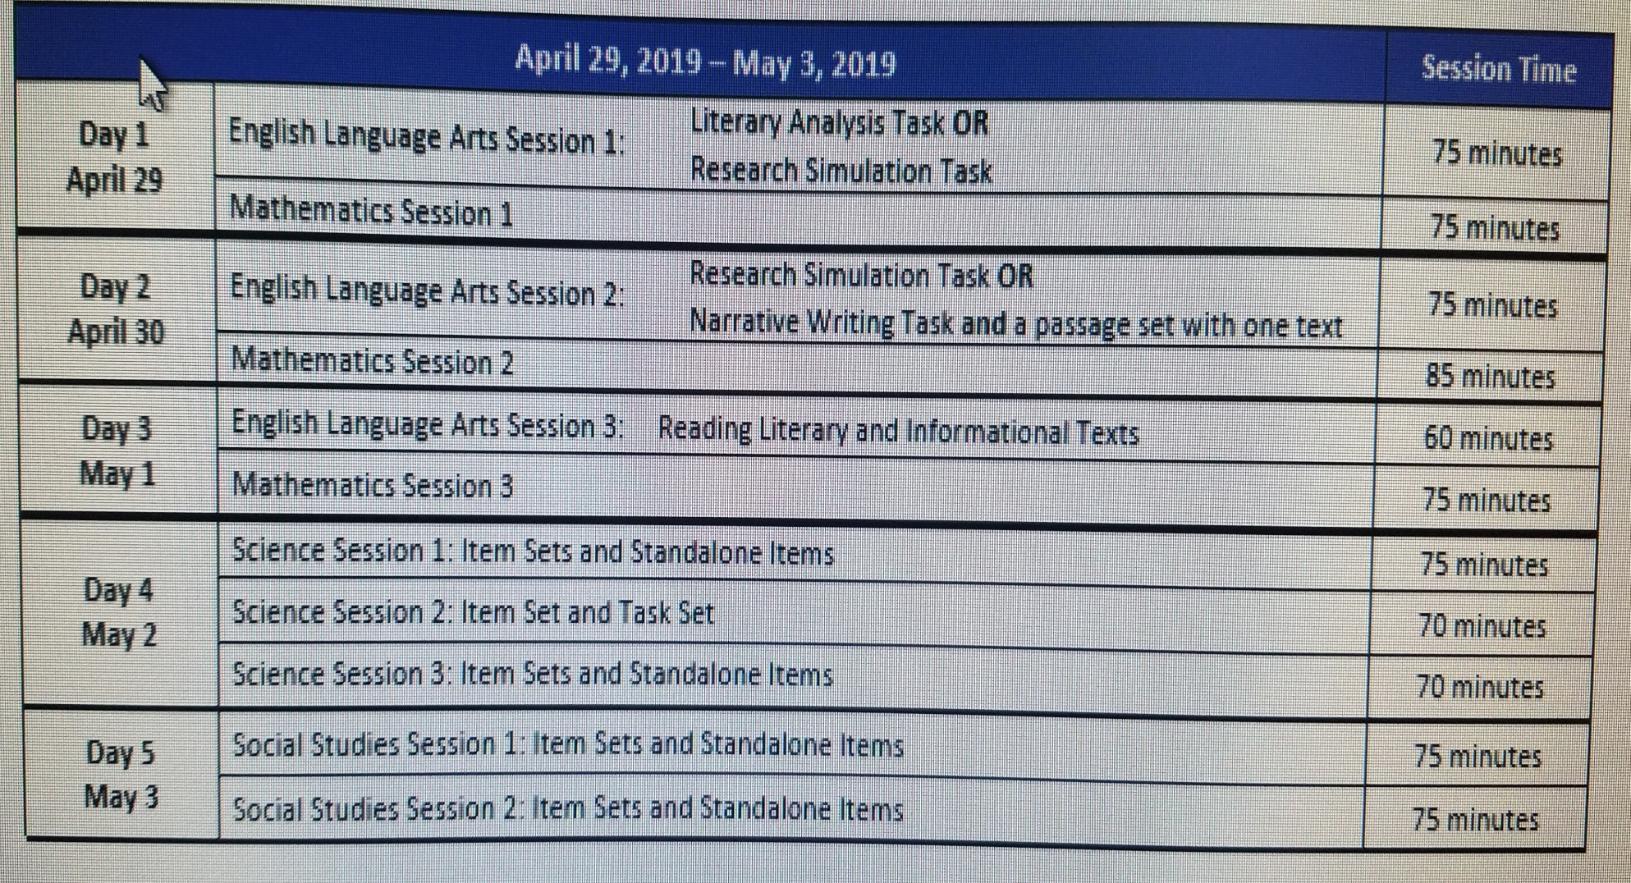
Testing Schedule

Slide 2
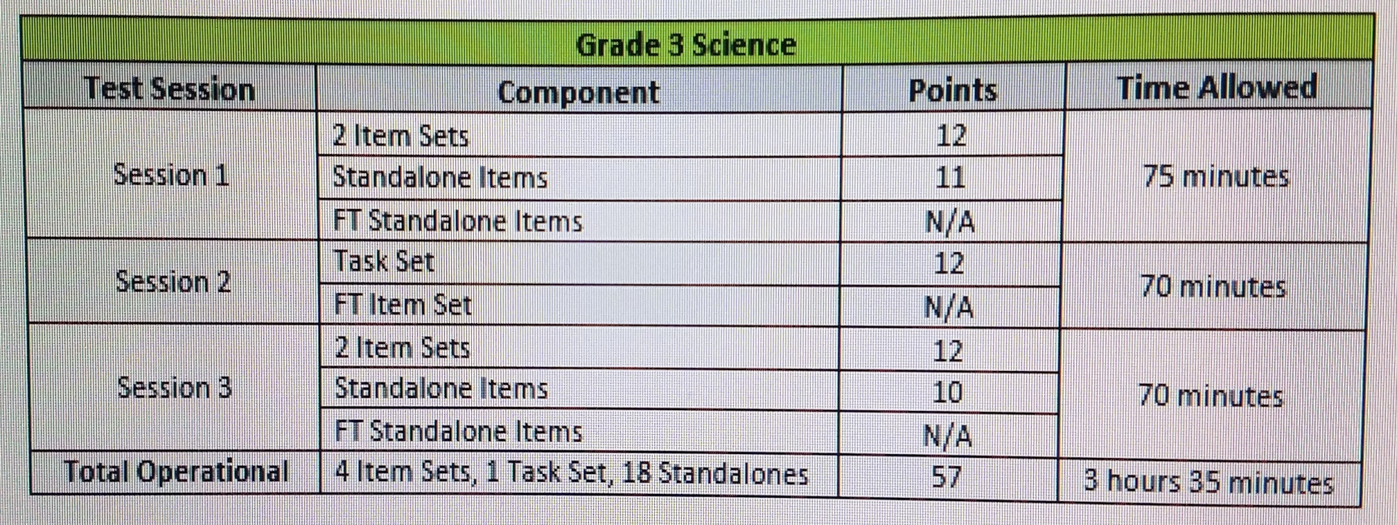
Science LEAP 2025
• Selected Response (SR): includes traditional multiple-choice (MC) questions with four answer options and only one correct answer, as well as multiple-select (MS) questions with five answer options and more than one correct answer. For MS items, the question identifies the number of correct answers. All SR items are worth one point each.
• Two-part SR: requires students to answer two related questions, worth two points. Two-part items may combine SR item types. o Two-part Dependent (TPD): the first SR must be correct in order to earn credit for the second SR item. o Two-part Independent (TPI): each SR is scored independently.
• Constructed Response (CR): requires a brief response provided by the student and will be scored using a 2-point rubric. These items may require a brief paragraph or a few sentences.
• Extended Response (ER): asks students to write a response that expresses the students’ ability to apply all three dimensions of the LSS for Science and will be scored using a 6-point rubric.

Slide 3
Social Studies LEAP 2025
LEAP 2025 Social Studies Test Design for Grade 3
Test Session Component Numbers and Types of Questions Points Time Allowed
Session 1
3 Item Sets 16 SR and 1 CR 18 75 minutes
Standalone Items 9 SR 9
Session 2 2 Item Sets 10 SR and 1 CR 12 75 minutes
1 Field Test Item Set* 4 SR and 1 CR or 6 SR 2 SR
2 Field Test Standalone Items* 2 SR N/A
Standalone Items 6 SR 6
Total Operational Form 5 Item Sets 41 SR, 2 CR 45 150 minutes
SR- selected response answers( multiple choice, multiple select).
CR- Constructed Response answers(write a brief response to a question that is scored using an item-specific rubric with a scale of 0-2 points).

Slide 4
Practice Tests
Can be found on my classroom website: seaysurvivorisland.weebly.com
Please click on the LEAP 2025 Tab and you will see all the files. Practice tests and Answer Keys.

Slide 5
LEAP 2025 ELA Assessment Design
There are three sessions on the LEAP 2025 ELA assessments, which consist of tasks and reading passages. Students take two tasks, one in Session 1 and
one in Session 2; the tasks require students to write an extended response that addresses the text(s). All students will take the Research Simulation Task.
The other task will be either the Literary Analysis Task or the Narrative Writing Task. See the table on page 4 for more information about the two
designs.
The tasks are described below.
• Research Simulation Task: mirrors the research process by presenting two texts on a given topic. Students answer a set of selected-response
questions about the texts and then write an extended response about some aspect of the related texts (e.g., relationship between a series of
events, ideas, or concepts; comparison/contrast of key details; the use of illustrations in the texts).
• Literary Analysis Task: provides students an opportunity to show their understanding of literature. It asks students to read two literary texts,
answer a set of selected-response questions about the texts, and write an extended response that compares and/or explains key ideas or
elements in the texts (e.g., central idea/message, contribution of illustrations, characterization).

Slide 6
• Narrative Writing Task: asks students to read a literary text, answer a set of selected-response questions about the text, and then create a
narrative related to the text (e.g., finish the story; retell the story in another narrative form, such as a journal entry). Students should make sure
that they create narrative, not expository, responses.
Session 3, Reading Literary/Informational Texts, asks students to read texts and answer questions to show their understanding of each text. The reading
selections may include fiction (e.g., short stories, novel and drama excerpts, poems) and non-fiction (e.g., informational texts from across the disciplines
of science, history, and the arts). Students will answer only selected-response questions about each text. No writing is included in this session.
NOTE: Session 3 will include 2 operational passage sets and 1 additional passage set that is being field tested. Each passage set includes one text
and 4 or 6 questions about the text(s). Only a student’s performance on the operational passages will count towards a student’s final score. The
field-test questions do not count towards a student’s final score on the assessment but are used to help develop future test forms.
The table on the next page outlines the two possible designs of the Grade 3 ELA assessment. The first part of the table shows the test design when the
Literary Analysis Task is administered, while the second part of the table shows the test design when the Narrative Writing Task is administered.

Slide 7
REPORTING CATEGORIES
Student performance on the LEAP 2025 ELA assessments will be reported by category and subcategory as outlined in the following table.
Category Subcategory Subcategory Description
Reading
Reading Literary Text Students read and demonstrate comprehension of grade-level fiction, drama, and poetry.
Reading Informational Text Students read and demonstrate comprehension of grade-level non-fiction, including texts
about history, science, and the arts.
Reading Vocabulary Students use context to determine the meaning of words and phrases in grade-level texts.
Writing Written Expression Students use details from provided texts to compose well-developed, organized, clear
writing.
Knowledge and Use of Language Conventions Students use the rules of Standard English (grammar, mechanics, and usage) to compose
writing.

Slide 8
These reporting categories provide parents and educators valuable information about
• overall student performance, including readiness to continue further studies in English language arts;
• student performance broken down by subcategories, which may help identify when students need additional support or more challenging work
in reading and writing; and
• how well schools and school systems are helping students achieve higher expectations.
Achievement-Level Definitions
Achievement-level definitions briefly describe the expectations for student performance at each of Louisiana’s five achievement levels:
• Advanced: Students performing at this level have exceeded college and career readiness expectations, and are well prepared for the next level
of studies in this content area.
• Mastery: Students performing at this level have met college and career readiness expectations, and are prepared for the next level of studies in
this content area.

Slide 9
• Basic: Students performing at this level have nearly met college and career readiness expectations, and may need additional support to be fully
prepared for the next level of studies in this content area.
• Approaching Basic: Students performing at this level have partially met college and career readiness expectations, and will need much support
to be prepared for the next level of studies in this content area.
• Unsatisfactory: Students performing at this level have not yet met the college and career readiness expectations, and will need extensive
support to be prepared for the next level of studies in this content area.

